Slide 1

Matthew 1:20-25, 2:1-2
Pastor Rod M. Lago

Slide 2
The Extra Ordinary Christmass
Matthew 1:20-25, 2:1-2
Pastor Road M. Lago

Slide 3
How to have An Extra Ordinary Christmas this year?

Slide 4
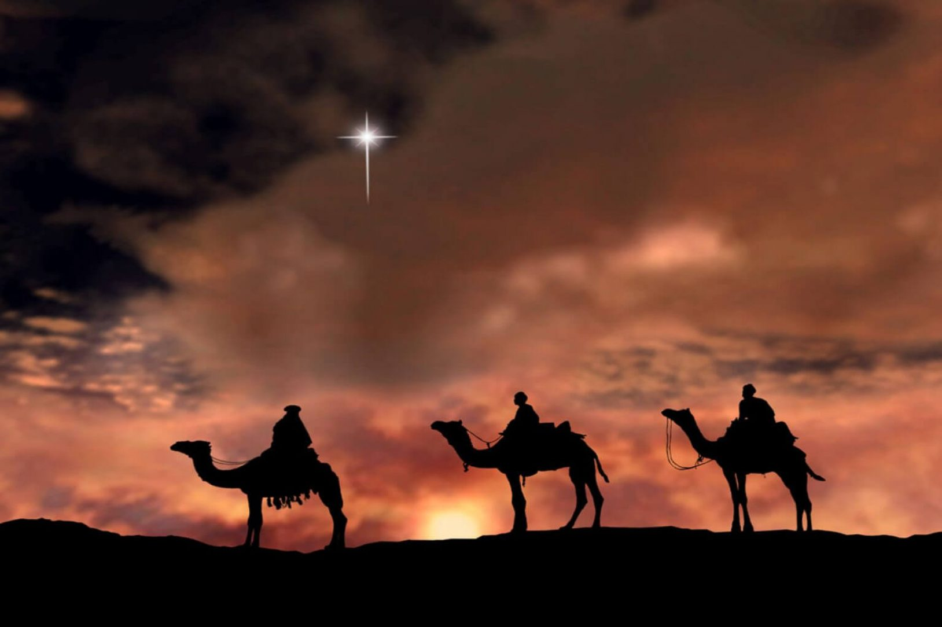
I. You Experience An Extra Ordinary Christmas when you realize that God still Speaks to People. 2:1-2

Slide 5
Job 33:14 New Century Version (NCV)
God does speak—sometimes one way and sometimes another—even though people may not understand it.

Slide 6

Four Channels that God Speaks….
God speaks to us through the Bible.
God speaks to us through His Servants.
God speaks to us through Impressions, Dreams and Visions.
God speaks to us through Circumstances

Slide 7
“God uses Ordinary people to do Extra Ordinary things. It doesn’t matter who we are. It matters Who He is.” – Christine Caine.

Slide 8
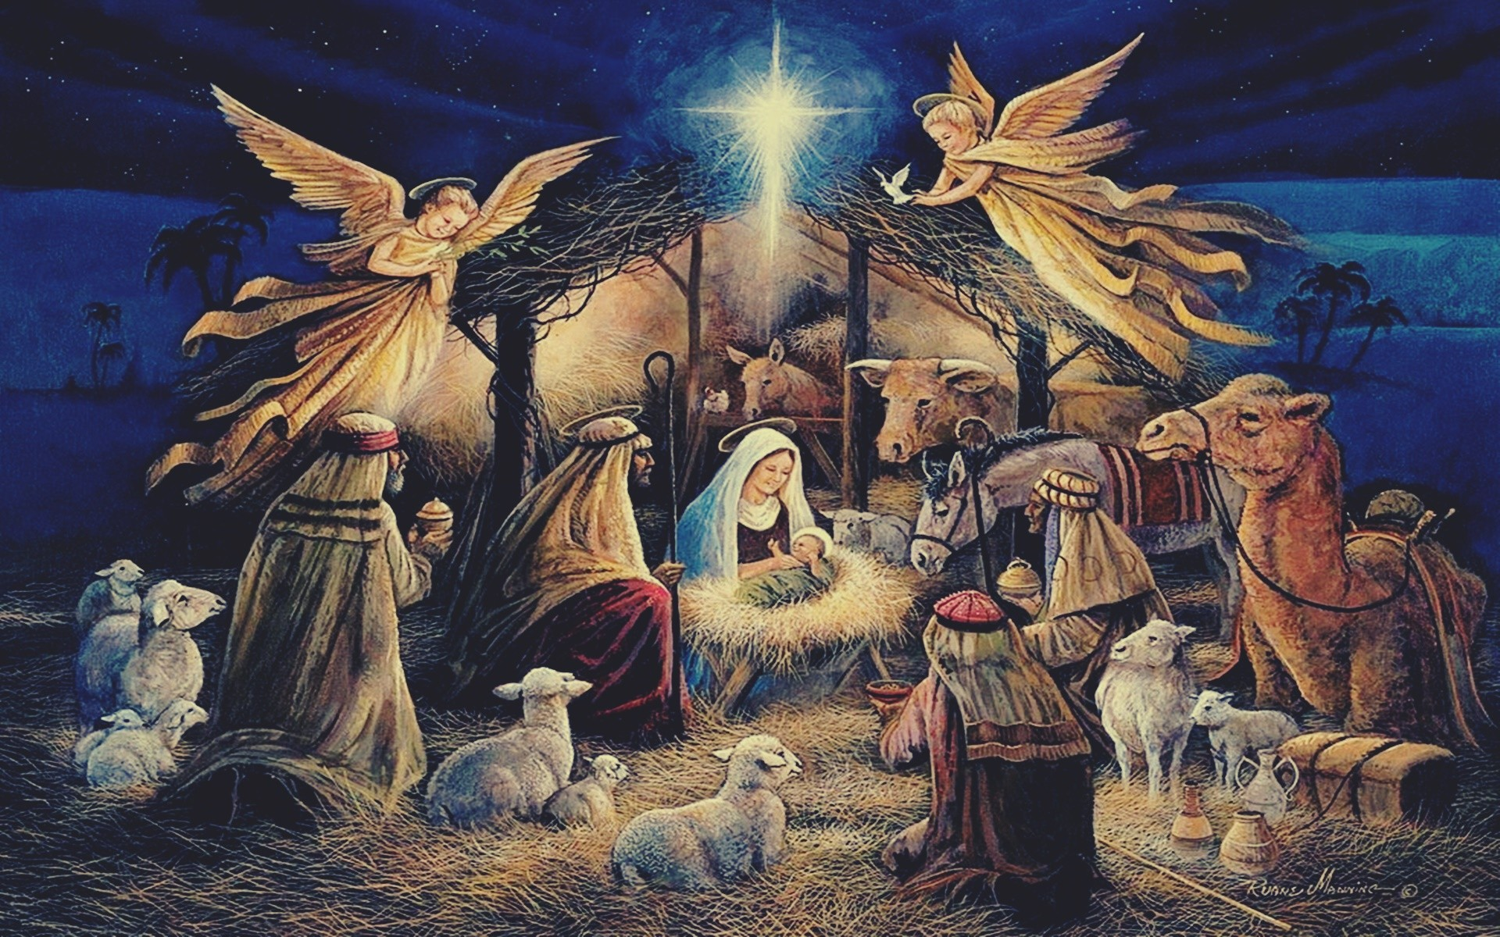
II. You Experience An Extra Ordinary Christmas when you realize God Still Saves People. – 1:21

Slide 9

JESUS means Savior

Slide 10
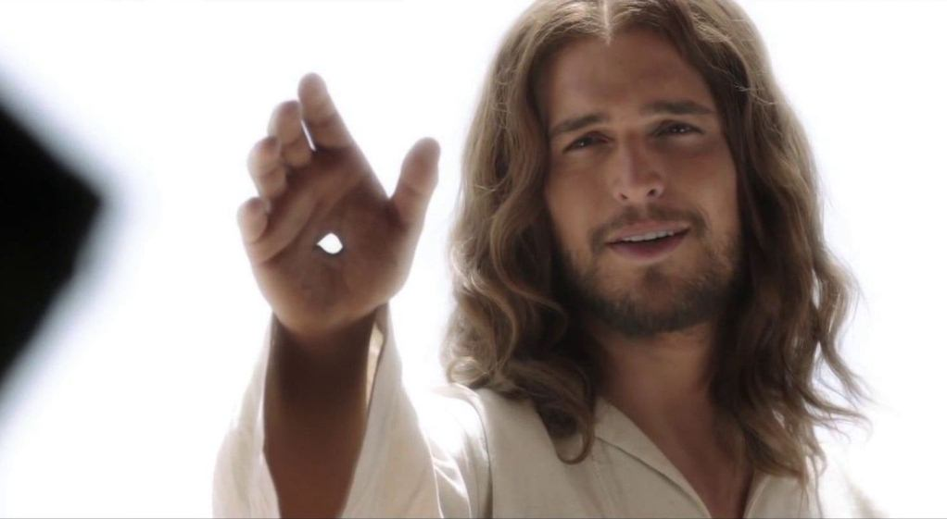
John 14:6 New International Version (NIV)
Jesus answered, “I am the way and the truth and the life. No one comes to the Father except through me.
Acts 4:12 New International Version (NIV)
12 Salvation is found in no one else, for there is no other name under heaven given to mankind by which we must be saved.”

Slide 11
Acts 16:30-31 New International Version (NIV)
30 He then brought them out and asked, “Sirs, what must I do to be saved?”
31 They replied, “Believe in the Lord Jesus, and you will be saved—you and your household.”

Slide 12
Romans 10:9-10 New International Version (NIV)
9 If you declare with your mouth, “Jesus is Lord,” and believe in your heart that God raised him from the dead, you will be saved. 10 For it is with your heart that you believe and are justified, and it is with your mouth that you profess your faith and are saved.

Slide 13
“JESUS is not one of the many ways to approach God, nor is He the best of several ways, He is the only Way.” – A.W. Towzer

Slide 14
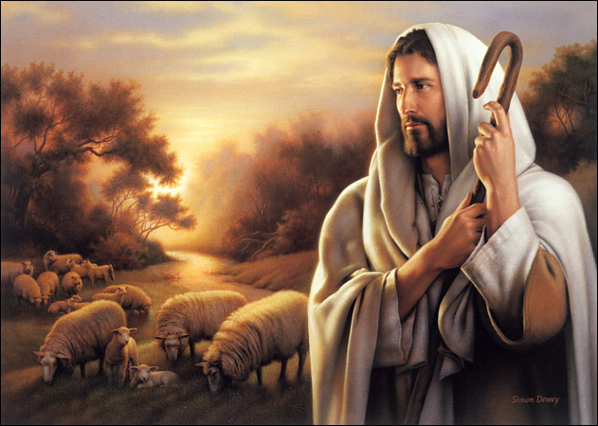
III. You Experience An Extra Ordinary Christmas when you realize God Still Stays with His People. 1:24

Slide 15

400 Silent Years.

Slide 16
God is going to do something Extra Ordinary this Christmas because…
He still can Speak to us.
He still can Save us.
He still can Stay with us.

Slide 17
1 John 4:9 New International Version (NIV)
This is how God showed his love among us: He sent his one and only Son into the world that we might live through him.

